Slide 1

Breast Cancer Classification Using a Stacking Ensemble Model with Explainable AI-Based Feature Importance Analysis
CSCI 7090 Data Science and Machine Learning Project
Team 1 Members:
Bright Agbenu
Sarah Sejoro

Slide 2
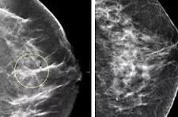
Introduction
Images of Breast Cancer
Breast Cancer accounts for approximately 15.5% of new cancer cases and 6.8% of all cancer‑related deaths in 2025
5‑year relative survival rate of nearly 91.7%. (CDC, 2025)
13% lifetime risk in women and 1% lifetime risk in men (ACS, 2026)
Leading cause of mortality in women worldwide
Early and accurate diagnostic interventions are essential

Slide 3
Why the study matters
Images of Breast Cancer
Use ensemble machine learning models that can help improve predictive accuracy of breast cancer
Limited studies on interpretability and explainability aspects of breast cancer prediction in DS/ ML models.
To evaluate whether XAI features are consistent across modelsand identify stable biomarkers in breast cancer diagnosis.

Slide 4
Research Questions
RQ 1: Can ensemble machine learning models improve predictive accuracy and diagnostic performance compared to individual models?
RQ 2: What combination of ensemble methods with explainable AI (XAI) can improve breast cancer prediction and interpretability?
RQ 3: Which features are consistently identified as important across different XAI methods?
RQ 4: Do different explanation techniques agree on feature importance?

Slide 5
Updates on Our Team’s Project
Implemented a ML pipeline after data acquisition, preprocessing, and EDA
Evaluate models’ performance
Use XAI for feature importance, correlation, and model agreement analyses.

Slide 6

Data Acquisition and Inspection
Data Source
Source: UCI Machine Learning Repository, Breast Cancer Wisconsin (Diagnostic).
The 30 real-valued predictors come from digitized fine needle aspirate images and describe cell nucleus characteristics.
The target is a clinically meaningful binary diagnosis label: benign (B) or malignant (M).
The dataset contained no missing data except one empty column
Data Reference
Notes:
[Sources] - UCI Machine Learning Repository, Breast Cancer Wisconsin (Diagnostic): https://archive.ics.uci.edu/dataset/17/breast+cancer+wisconsin+diagnostic (accessed 2026-04-14). - User-provided notebook: Breast_Cancer_EDA_Notebook.ipynb (fetch code and dataset profile).

Slide 7
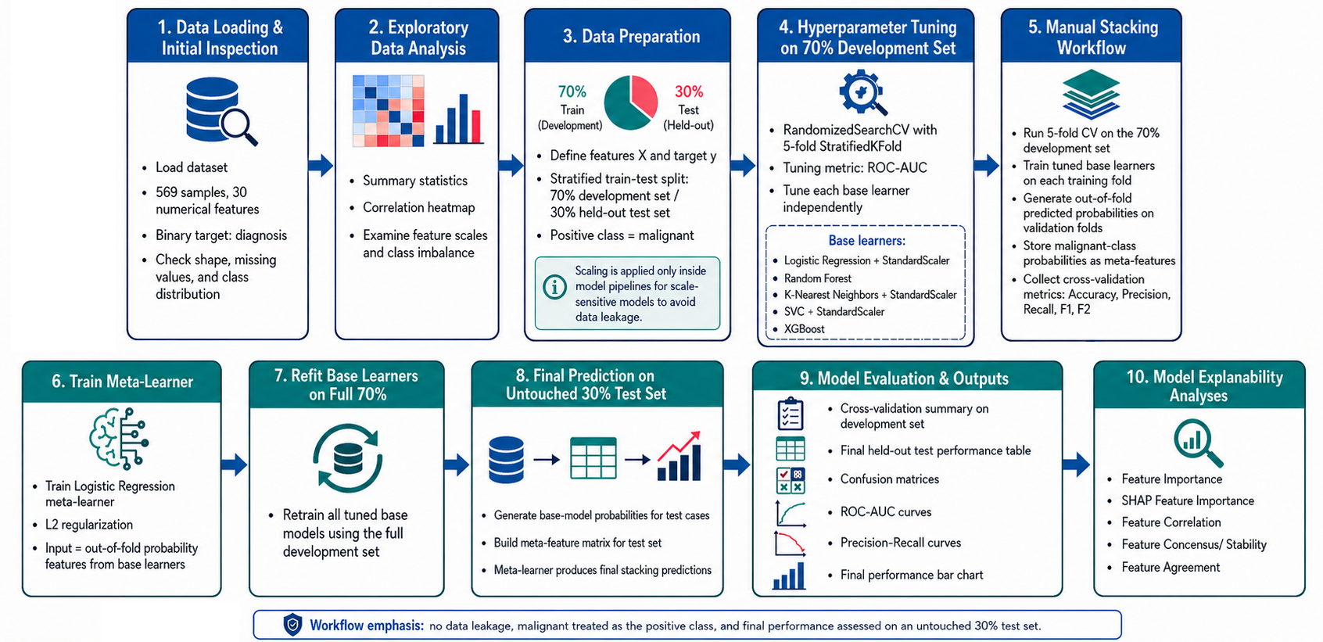
Machine Learning Pipeline for Breast Cancer Classification

Slide 8
Final Model Performance Evaluation on Held-out 30% Test Set
Model | Accuracy | Precision | Recall | F1-score | F2-score
Logistic Regression | 0.9708 | 0.9836 | 0.9375 | 0.9600 | 0.9464
Random Forest | 0.9649 | 0.9677 | 0.9375 | 0.9524 | 0.9434
K-Nearest Neighbors | 0.9415 | 0.9821 | 0.8594 | 0.9167 | 0.8814
SVC | 0.9649 | 0.9833 | 0.9219 | 0.9516 | 0.9335
XGBoost | 0.9415 | 0.9355 | 0.9062 | 0.9206 | 0.9119
Stacking Ensemble | 0.9825 | 0.9841 | 0.9688 | 0.9764 | 0.9718

Slide 9
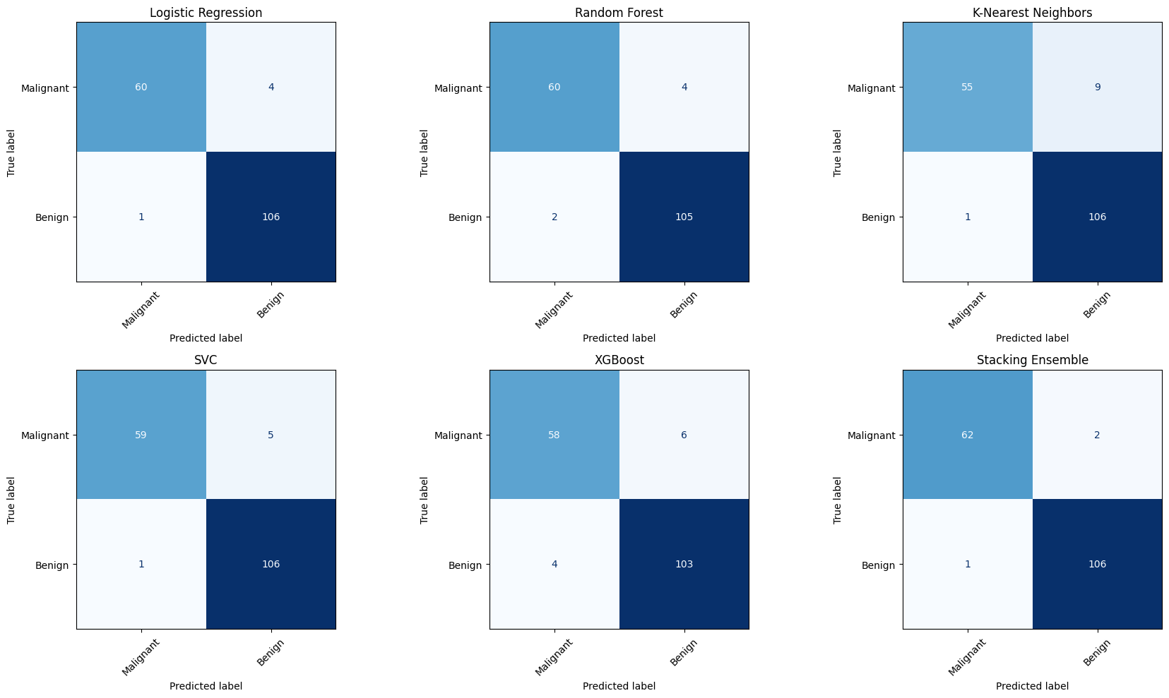
Confusion Matrices for All Models on Held-Out 30% Test Set

Slide 10
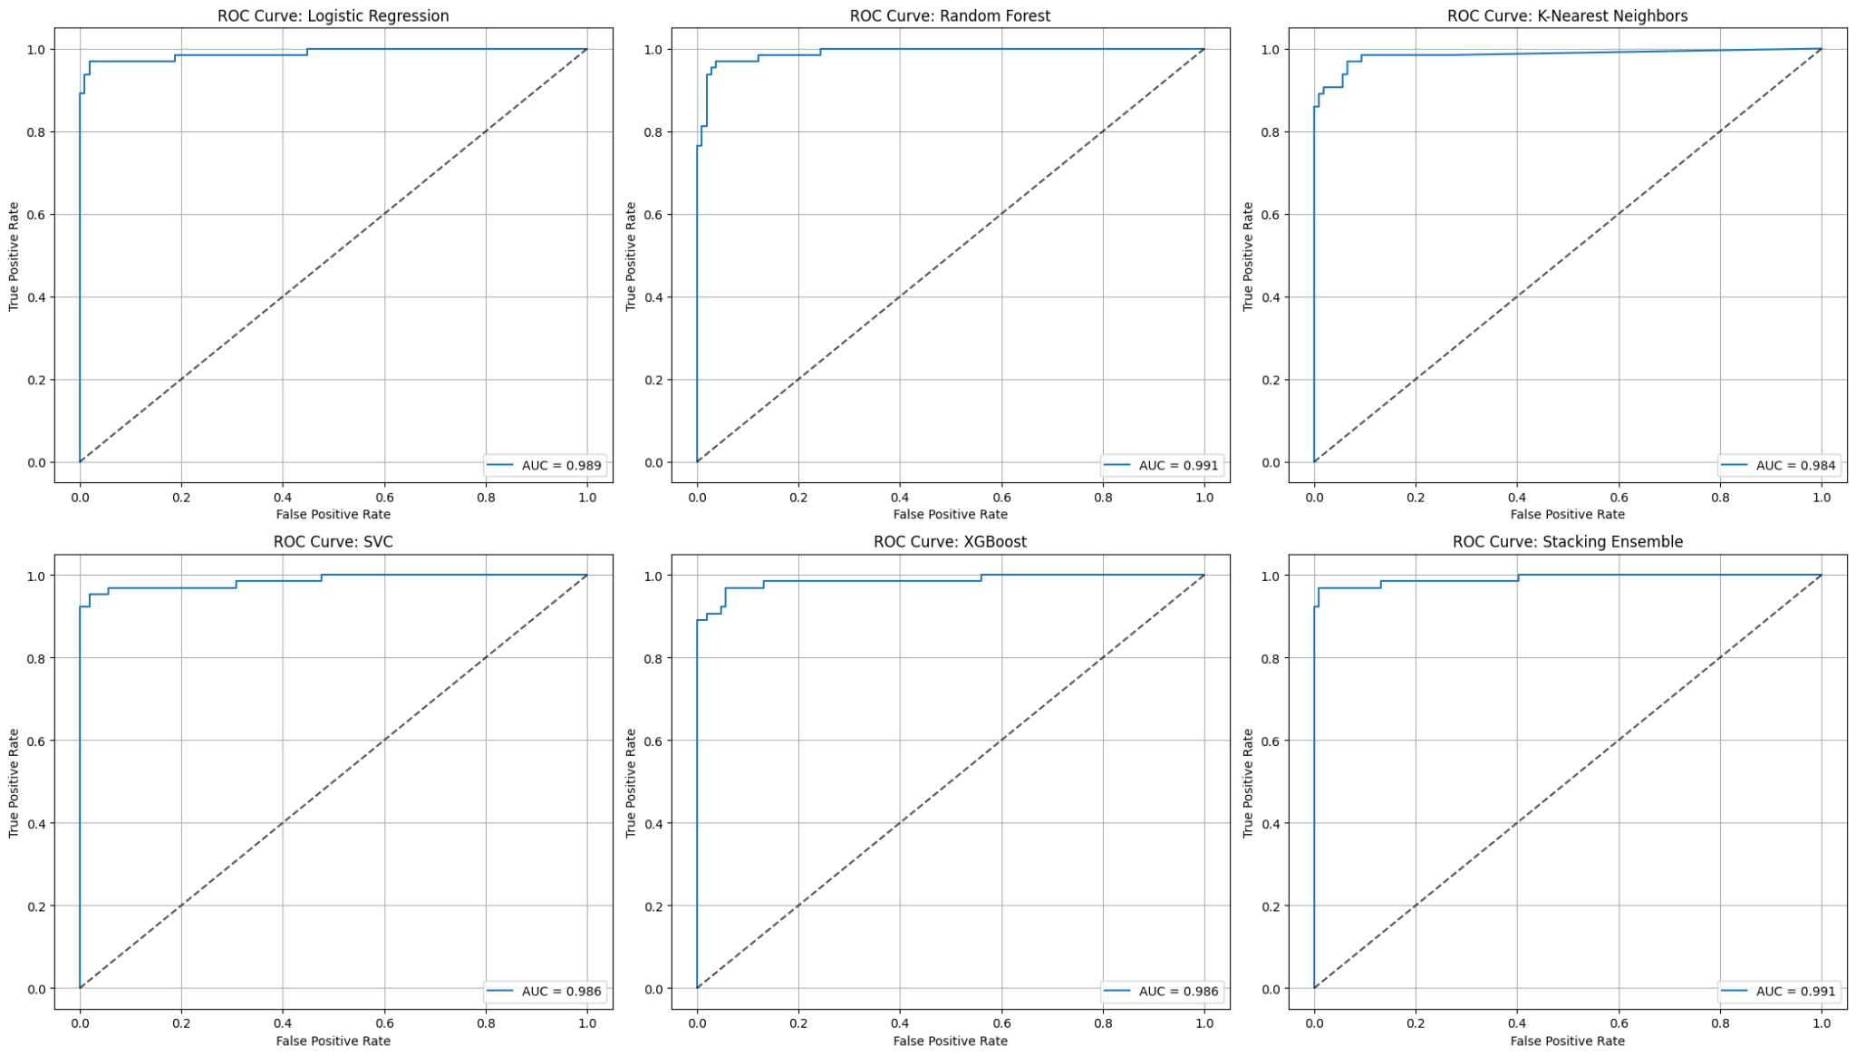
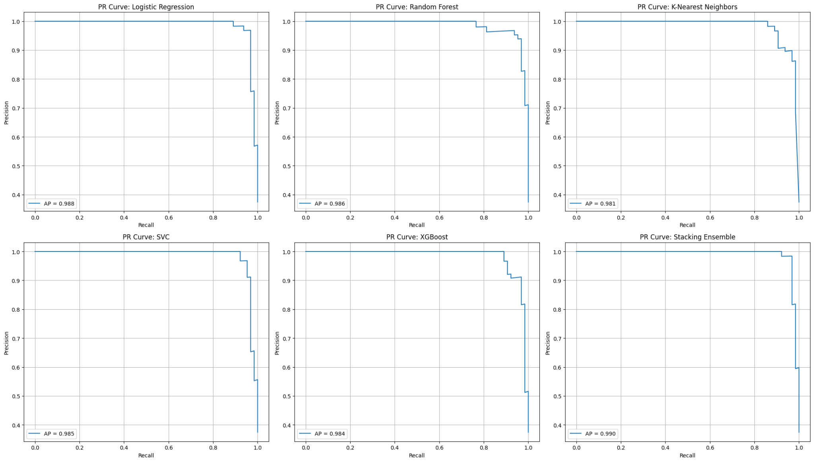
ROC-AUC & Precision-Recall Curves for All Models
All models showed excellent discrimination, with ROC-AUC values above 0.98 meaning they separated malignant and benign cases very well across thresholds.
The stacking ensemble had the strongest overall precision-recall performance, indicating the best balance between identifying malignant cases and limiting false alarms.

Slide 11
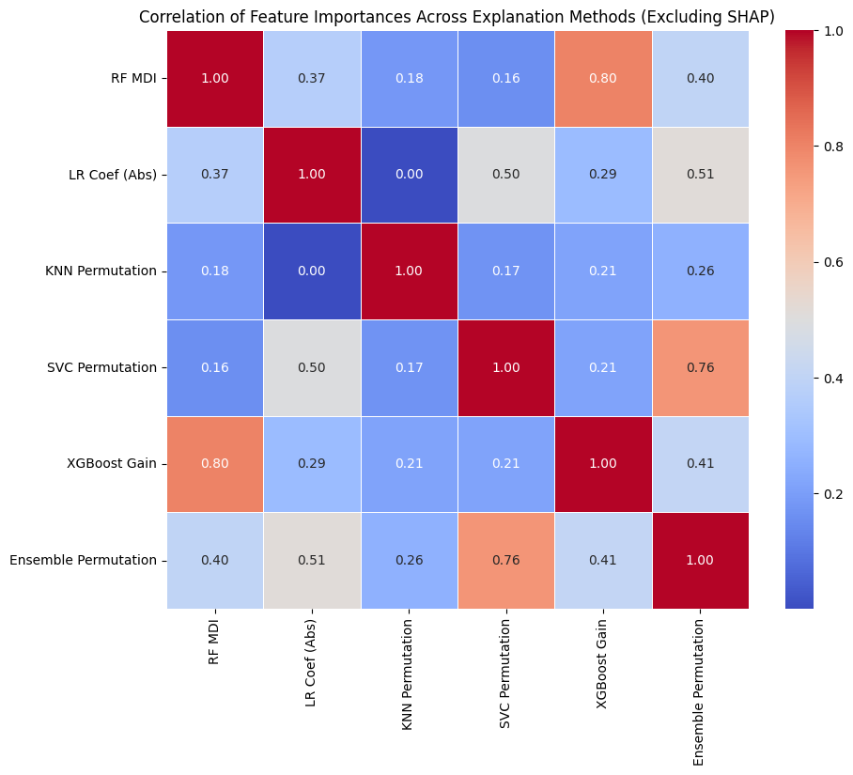
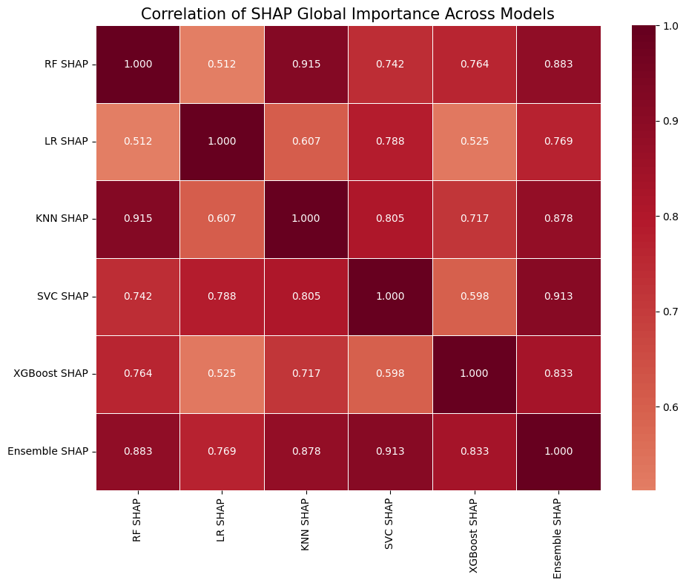
Correlation of Feature importance across models
XGBoost and Random Forest's Gini importance shows that worst area, worst concave points, worst radius were the most influential in reducing node impurity across RF trees.
Logistic regression feature importance shows us that worst texture, worst concave points, worst radius features were most associated with an increased log odds of malignant breast cancer diagnosis
KNN permutation importance shows that worst texture, worst radius, worst smoothness are the features that most affect the KNN model's accuracy

Slide 12
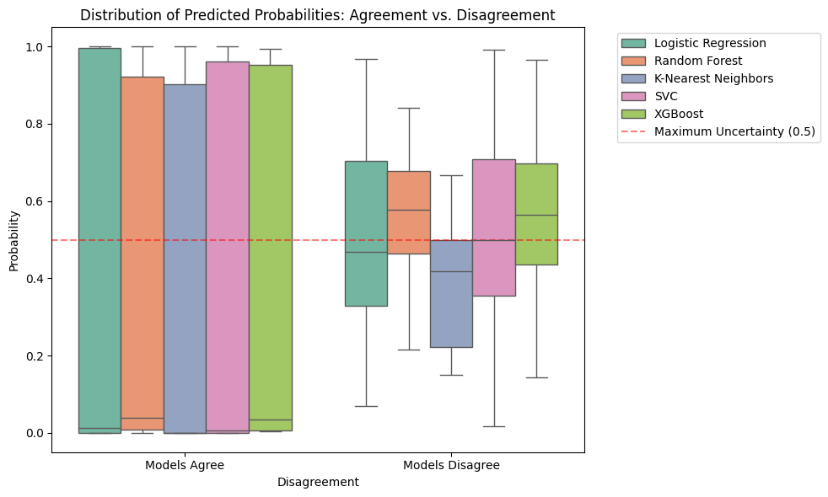
Predicted Probability of Agreement and Disagreement across Models
Distribution of predicted probabilities across models under agreement and disagreement scenarios
Near 0.5 → increased uncertainty or disagreement in classification.
Near 0 or 1 → Models are consistent and confident in benign (0) or malignignant (1) classification.
Disagreement cases are important because they may require additional tests or expert review before making a final diagnosis.
The plot shows that our ensemble is confident for most tumors, but it also identifies borderline cases.
Notes:
Instances on the left are cases where all base models predicted the same outcome; on the right, models disagreed.

Slide 13
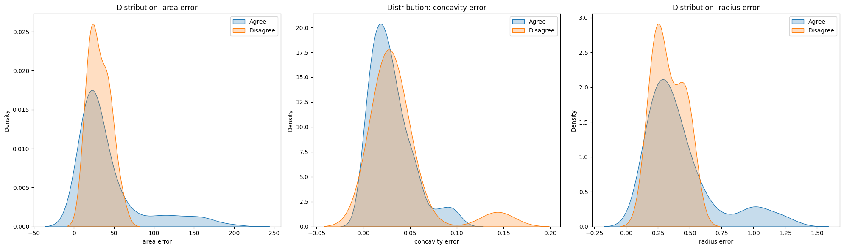
Features with Largest Mean Differences in Disagreement Cases

Slide 14
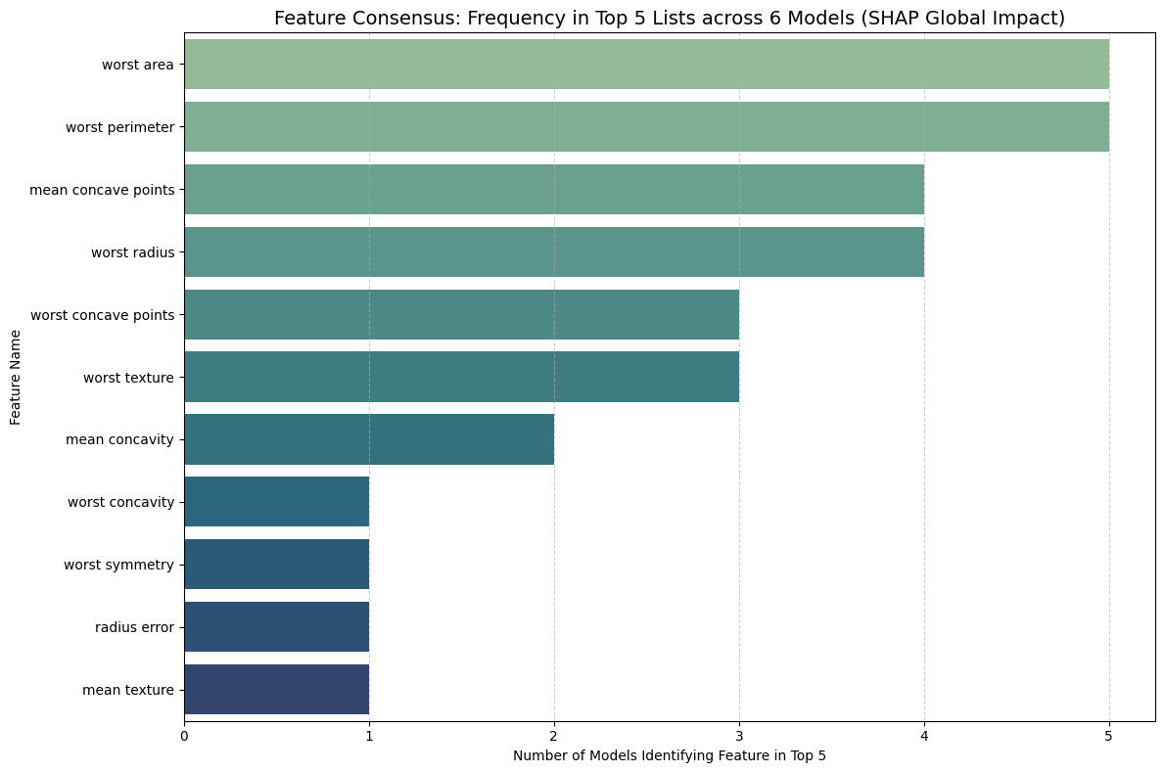
Top 10 Feature importance Concensus across XAI models
The Feature consensus-frequency plot shows that worst concave points and worst radius appear in the top 5 features across all four XAI methods, while worst area appears in three models.

Slide 15
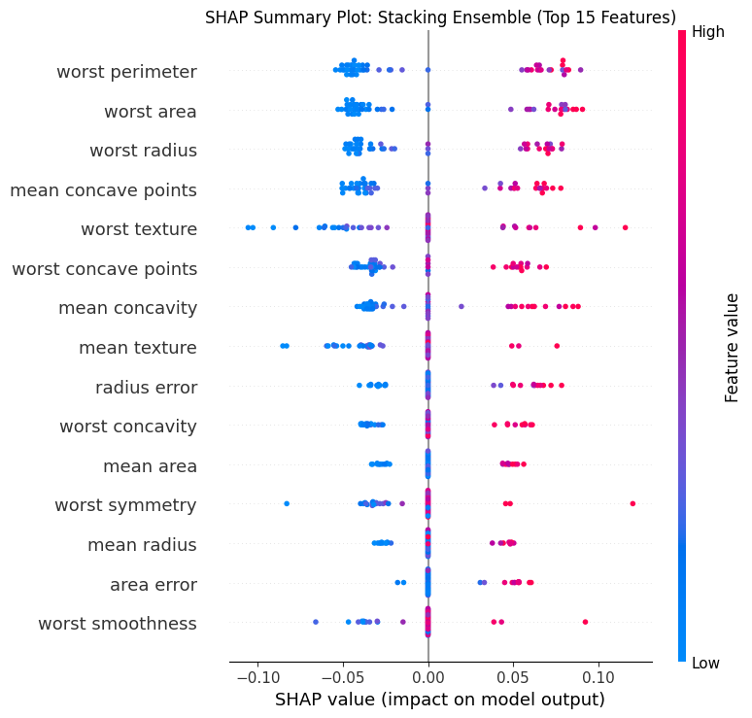
SHAP Summary Plot: Stacking Ensemble Model
This plot shows which features matter most in the ensemble in an interpretable way.
SHAP confirms which features consistently influence the logistic regression meta-model, regardless of base model disagreements.
Worst perimeter, worst area, worst radius were ranked high as biomarkers important in breast cancer prediction.

Slide 16
Summary of Findings
Stacking Ensemble model performed best among all models
Different models emphasize different diagnostic features
This study demonstrates that building trust in the use of machine learning in breast cancer diagnostics requires evaluating not only predictive performance, but also the consistency and stability of model explanations.
Feature importance rankings varied across models and XAI methods, demonstrating that interpretability is model-dependent.
Stacking ensemble model achieved the best overall classification performance under cross-validation.
Consensus across models and XAI methods identified consistent predictive diagnostic features such as worst perimeter, worst area, worst radius.
Real World Application
Agreement, consensus, among heterogenous ensemble and explainable AI methods can be useful in determining important biomarkers in cancer prediction and confidence in findings.
Useful in Cancer research, genomics, and environmental health.
Can help provide consistent explainations and increase trust in clinical decisions support.
Limitations
Small dataset
Limited Generalizability
Conclusion and Future Studies
Trustworthy interpretation in breast-cancer ML should be based on agreement, not a single model’s ranking.
Future work could incorporate class-weighted learning or resampling techniques to evaluate the impact of class imbalance on model disagreement.

Slide 17

Video of our Codes and Analysis

Slide 18
References
Makki, J. (2015). Diversity of breast carcinoma: Histological subtypes and clinical relevance. Clinical Medicine Insights: Pathology, 8, 23–31. https://doi.org/10.4137/CPath.S31563
Wolberg, W., Mangasarian, O., Street, N., & Street, W. (1993). Breast Cancer Wisconsin (Diagnostic) [Dataset]. UCI Machine Learning Repository. https://doi.org/10.24432/C5DW2B.
National Cancer Institute (2025). Retrieved from https://seer.cancer.gov/statfacts/html/breast.html. Assessed on Feb 20, 2026.
American Cancer Society (2026). Retrieved from https://www.cancer.org/cancer/types/breast-cancer/about/how-common-is-breast-cancer.html. Assessed on Feb 20, 2026.
Shang, C., & Xu, D. (2022). Epidemiology of breast cancer. Oncologie, 24(4), 649–663. https://doi.org/10.32604/oncologie.2022.027640
Jaglan, P., Dass, R., & Duhan, M. (2019). Breast cancer detection techniques: Issues and challenges. Journal of the Institution of Engineers (India): Series B, 100(4), 379–386. https://doi.org/10.1007/s40031-019-00391-2
La Moglia, A., & Almustafa, K. M. M. (2025). Breast cancer prediction using machine learning classification algorithms. Intelligence-Based Medicine, 11, 100193. https://doi.org/10.1016/j.ibmed.2024.100193
Yue W, Wang Z, Chen H, Payne A, Liu X. 2018. Machine learning with applications in breast cancer diagnosis and prognosis. Designs. 2(2):13. doi: 10.3390/designs2020013.
Ahsan, M. M., Luna, S. A., & Siddique, Z. (2022). Machine-learning-based disease diagnosis: A comprehensive review. Healthcare (Basel), 10(3), 541. https://doi.org/10.3390/healthcare10030541
Manzoor, M. (2024). Machine learning for early disease diagnosis: A review of techniques in healthcare applications. Premier Journal of Science, 2(4). https://doi.org/10.5281/zenodo.14095684
Moreno-Ibarra, A., et al. (2021). Classification of diseases using machine learning algorithms: A comparative study. Mathematics, 9(15), 1817. https://doi.org/10.3390/math9151817
Scherr, T. F., Douglas, C. E., Schaecher, K. E., Schoepp, R. J., Ricks, K. M., & Shoemaker, C. J. (2024). Application of a machine learning-based classification approach for developing host protein diagnostic models for infectious disease. Diagnostics (Basel), 14(12), 1290. https://doi.org/10.3390/diagnostics14121290

Slide 19
References
Jafari, A. (2024). Machine-learning methods in detecting breast cancer and related therapeutic issues: A review. Computer Methods in Biomechanics and Biomedical Engineering: Imaging & Visualization, 12(1), Article 2299093. https://doi.org/10.1080/21681163.2023.2299093
La Moglia, A., & Almustafa, K. M. (2025). Breast cancer prediction using machine learning classification algorithms. Intelligence-Based Medicine, 11, Article 100193. https://doi.org/10.1016/j.ibmed.2024.100193
Yedjou, C. G., Tchounwou, S. S., Aló, R. A., Elhag, R., Mochona, B., & Latinwo, L. (2021). Application of machine learning algorithms in breast cancer diagnosis and classification. International Journal of Science and Academic Research, 2(1), 3081–3086.
Brunyé, T. T., Booth, K., Hendel, D., Kerr, K. F., Shucard, H., Weaver, D. L., & Elmore, J. G. (2024). Machine learning classification of diagnostic accuracy in pathologists interpreting breast biopsies. Journal of the American Medical Informatics Association : JAMIA, 31(3), 552–562. https://doi.org/10.1093/jamia/ocad232
Al-Azzam, N., & Shatnawi, I. (2021). Comparing supervised and semi-supervised machine learning models on diagnosing breast cancer. Annals of Medicine and Surgery, 62, 53–64. https://doi.org/10.1016/j.amsu.2020.12.043
Li, X., Li, C., Wang, H., Jiang, L., & Chen, M. (2024). Comparison of radiomics-based machine-learning classifiers for the pretreatment prediction of pathologic complete response to neoadjuvant therapy in breast cancer. PeerJ, 12, e17683. https://doi.org/10.7717/peerj.17683
Xiao, J., Mo, M., Wang, Z., Zhou, C., Shen, J., Yuan, J., He, Y., & Zheng, Y. (2022). The application and comparison of machine learning models for the prediction of breast cancer prognosis: Retrospective cohort study. JMIR Medical Informatics, 10(2), e33440. https://doi.org/10.2196/33440
Yao, J., Zhou, W., Xu, S., Jia, X., Zhou, J., Chen, X., & Zhan, W. (2024). Machine learning-based breast tumor ultrasound radiomics for pre-operative prediction of axillary sentinel lymph node metastasis burden in early-stage invasive breast cancer. Ultrasound in Medicine & Biology, 50(2), 229–236. https://doi.org/10.1016/j.ultrasmedbio.2023.10.004
Zhou, S., Hu, C., Wei, S., & Yan, X. (2024). Breast cancer prediction based on multiple machine learning algorithms. Technology in Cancer Research & Treatment, 23, 15330338241234791. https://doi.org/10.1177/15330338241234791

